Slide 1
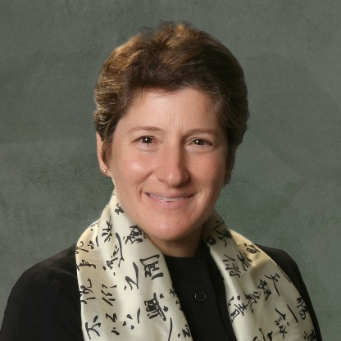

化工学院第七届国际交流月系列讲座
Prof. Julie Kornfield
Division of Chemistry and Chemical Engineering
California Institute of Technology
Dr. Julie Kornfield– Professor of Chemical Engineering at California Institute of Technology is an expert in polymer physics, including the physical properties of ocular tissues (cornea, sclera, vitreous). She has won numerous awards, including the Dillon Medal of the American Physical Society, and is a Fellow of the American Association for the Advancement of Science. She is a co-founder of Calhoun Vision and led the development of the material now used to make intraocular lens implants that can be adjusted non-invasively after implantation. Her research on the cornea of the eye includes in vitro studies of guided tissue regeneration and therapeutic crosslinking with very low toxicity. Her current research includes studies of liquid-crystalline elastomers, bottlebrush polymers, flow-induced crystallization of polymers and associative polymers for improved safety and performance of fuels.
June 20th, 2016 7:00 - 9:00 pm Room 502 - Building 7
Lecture 1: Helping the Corneal Stroma Stay in Shape
The cornea of the eye is a remarkable collagen-based hydrogel that is 78%wt water, yet it has the strength to serve as a stable optical element despite continuous tension imposed by intraocular pressure. The cornea’s balance of clarity and permeability with mechanical strength is maintained by the constant degradation and replacement of its constituents. When these are out of balance either due to excessive degradation or insufficient replacement, the cornea begins to bulge outward (e.g. keratoconus). Through a Caltech-UCSF collaboration we have developed a gentle method to reinforce the tissue using photoactivated crosslinking of the biomolecules already present in the stroma. The crosslinking is activated by visible light (using green light to activate the photosensitizer eosin Y), which shows low toxicity to the cells in the corneal stroma (keratocytes) and behind it (corneal endothelial cells). To progress to the clinic, we are exploring novel, minimally invasive ways to penetrate the cornea’s epithelial barrier for drug delivery. This talk will present the visible-light photocrosslinking method, the reason that it motivates drug delivery to the stroma without disruption of the epithelium, and the approach we are exploring to achieve it.
Lecture 2: Finding the Binding Site of Luminate®, a Therapeutic Peptide for Retinal Disease (Dan Zhou, Ph.D. Student)
Diabetic and age-related retinopathies, both associated with growth of abnormal blood vessels, are leading causes of blindness in the developed world. Current treatments, such as Laser Photocoagulation and anti-Vascular Endothelial Growth Factor (VEGF) drugs, have limited efficacy and undesirable side effects. A recently discovered therapeutic peptide Luminate® (Allegro Ophthalmics, LLC) has proven to be effective in human clinical trials. Over half of the patients in Phase I Human studies demonstrated vision improvement with 4 lines or over, and in some patients, the macular thicknesses was reduced back to the healthy state. It has shown significantly longer lasting benefits than anti-VEGF treatments and shows synergistic effects when used with them. Thus, the peptide appears to act through a different pathway than anti-VEGF agents. Finding that pathway might give new insights into the retinopathies and their managements. Therefore, we are using the peptide as a tool to find the molecular mechanism of its clinically observed therapeutic effects.
The peptide and its scrambled counterparts are used to prepare fluorophore-peptide conjugates and peptide-directed coupling reagents. Results will be presented from in-vitro and ex-vivo experiments to visualize the distribution of Luminate binding using fluorophore-peptide conjugates. Progress toward enrichment of binding using ligand-directed receptor “pull down” will be described. Our goal is to enrich and identify the associated receptors by drug-directed crosslinking and immunopercipitation. If successful, identification of the receptor that binds Luminate could provide further insight into the molecular basis of retinopathies, which could guide novel therapeutic agents to prevent vision loss.
邀请人：王文俊
化学工程与生物工程学院
化学工程联合国家重点实验室（浙江大学）

