Slide 1
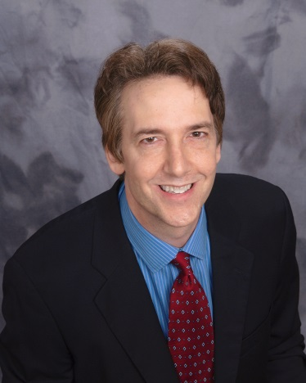
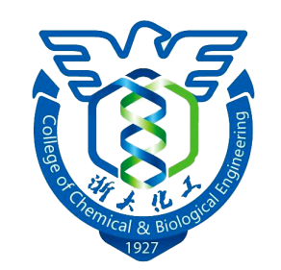
化工学院第七届国际交流月系列讲座
Professor Steven J. Severtson
Department of Bioproducts and Biosystems Engineering
University of Minnesota – Twin Cities
Dr. Steve Severtson is a Professor in the Department of Bioproducts and Biosystems Engineering at the University of Minnesota -Twin Cities and a Qiushi Chair Professor in the Department of Chemical and Biological Engineering at Zhejiang University. His current research projects include the study of wetting and adhesion involving soft substrates, characterization of small molecule migration in polymer films and development of environmentally benign coatings and adhesives. Prof. Severtson received his B.A. (chemistry major) from Augsburg College (Minneapolis, MN), M.S.M.E. from Georgia Tech. and Ph.D. from IPST, which is currently IPST at Georgia Tech. Prior to joining the faculty at the University of Minnesota, Prof. Severtson spent 3 years working as a Senior Chemist for Nalco Chemical Company (Naperville, IL).
June 21st, 2016 10:00 am - 12:00 pm Room 602 - Building 7 Design, Characterization and Surface Wetting of High Biomass Content Polymers for Adhesive and Coating Applications
This presentation will review several of my research group’s projects aimed at development of polymeric products using novel approaches and components. Copolymers containing high renewable biomass contents were generated in reactions of lactide-based macromonomers with monomers traditionally used in acrylic-based adhesives and coatings. Macromonomers were generated by catalyzed, ring opening polymerizations of L-lactide and -caprolactone initiated with protic acrylates such as hydroxyethyl methacrylate (HEMA). Adhesives synthesized using both mini-emulsion and solution polymerizations have excellent performance properties, high recycling compatibility and greater biodegradability. Polymer properties were shown to be highly tunable with macromonomer composition. Thermoplastics produced for adhesive applications possess anomalous wetting behavior resulting from the formation of large wetting ridges at the contact line. These deformations inhibit wetting line propagations resulting in the arbitrary selection of contact angles, formation of quasi-periodic ridge surface structures, and the requirement of stick and break motion for wetting line advancement. Also discussed will be the use of polymerizable emulsifiers or surfmers to generate latex polymers. Surfmers were shown to prevent degradation of latex coating properties due to surface enrichment by surfactants and enhance film strength. Use of surfmers derived from renewable sources provides another means to incorporate biomass into latex polymers for a variety of applications.
邀请人：王文俊
化学工程与生物工程学院
化学工程联合国家重点实验室（浙江大学）

